Slide 1
Data Analysis using Spark (Airlines Data)

Slide 2
1.Introduction
1.1 Purpose
The purpose of this project is to show how a data warehouse is created and how analytics is performed, based on our requirements.
The tool being used here is Spark.
1.2 Objectives
The following are the modules in this proposed system
Store/Stage the data inside AWS S3.
Build a centralized repository.
Create ETL Processes and perform desired operations.
Generate Output in JSON Format

Slide 3
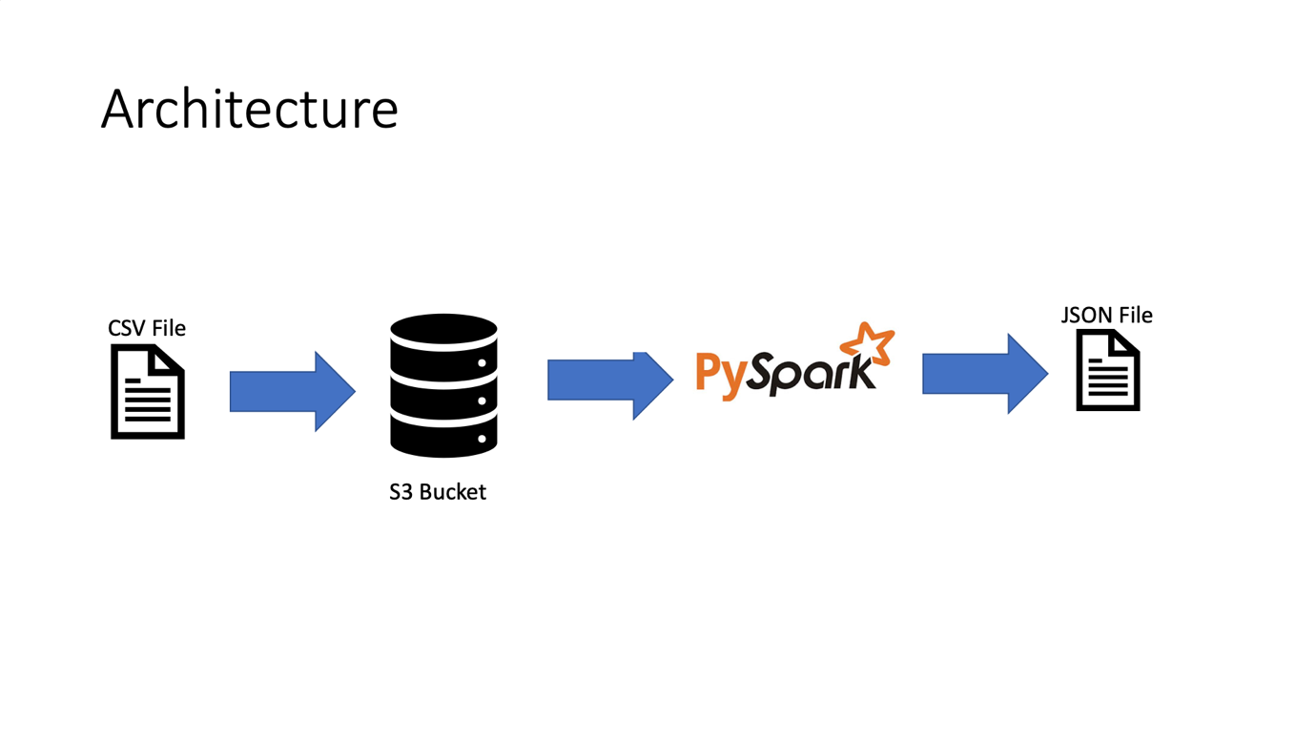
2.Architecture
Physical Architecture:
Source Data Format: CSV
Staging Tool: S3
ETL Tool: Spark API: PySpark/Spark
Output Data Format: JSON

Slide 4
3.Table Definitions & Mappings.
Name | Description
Year | 2007
Month | 1-12
DayofMonth | 1-31
DayOfWeek | 1 (Monday) - 7 (Sunday)
DepTime | actual departure time (local, hhmm)
CRSDepTime | scheduled departure time (local, hhmm)
ArrTime | actual arrival time (local, hhmm)
CRSArrTime | scheduled arrival time (local, hhmm)
UniqueCarrier | unique carrier code
FlightNum | flight number
TailNum | plane tail number
ActualElapsedTime | in minutes
CRSElapsedTime | in minutes
ArrDelay | arrival delay, in minutes
DepDelay | departure delay, in minutes
Origin | origin IATA airport code
Dest | destination IATA airport code
Distance | in miles
TaxiIn | taxi in time, in minutes
TaxiOut | taxi out time in minutes
Cancelled | was the flight cancelled?
CancellationCode | reason for cancellation (A = carrier, B = weather, C = NAS, D = security)
Diverted | 1 = yes, 0 = no
CarrierDelay | in minutes
WeatherDelay | in minutes
NASDelay | in minutes
SecurityDelay | in minutes
LateAircraftDelay | in minutes

Slide 5
4.Tasks to perform
Find the most Frequent tailnumber which is getting in destination by maximum.
Find out the cancelled flight details for the last quarter.
Find out the average weather delays for a particular flight per month.
Monthwise total distance travelled by each flight number
Month wise how many get diverted (origin to destination)
Week and monthwise num of trips in all the flights.
Which flights covered maximum origin and destination by month wise
Average monthwise arrival delay
Average month wise departure delays
Which carrier performs better?
When is the best day of week/time of year to fly to minimise delays?
Can you detect cascading failures as delays in one airport create delays in others? Are there critical links in the system?
Month-wise percentage of cancellation reason
Do older planes suffer more delays?

Slide 6
5.Technologies Used
5.1 Amazon S3
Amazon Simple Storage Service (Amazon S3) is storage for the Internet. It is designed to make web-scale computing easier for developers.
Amazon S3 has a simple web services interface that you can use to store and retrieve any amount of data, at any time, from anywhere on the web. It gives any developer access to the same highly scalable, reliable, fast, inexpensive data storage infrastructure that Amazon uses to run its own global network of web sites.
5.1.1 Advantages
Creating buckets – Buckets are the fundamental containers in Amazon S3 for data storage.
Storing data – Store an infinite amount of data in a bucket. Upload as many objects as you like into an Amazon S3 bucket. Each object can contain up to 5 TB of data.
Downloading data – Download your data or enable others to do so.
Permissions – Grant or deny access to others who want to upload or download data into your Amazon S3 bucket.

Slide 7
5.2 Spark
Apache Spark is a data processing framework that can quickly perform processing tasks on very large data sets, and can also distribute data processing tasks across multiple computers, either on its own or in tandem with other distributed computing tools. These two qualities are key to the worlds of big data and machine learning, which require the marshalling of massive computing power to crunch through large data stores.
5.2.1 Spark vs. Hadoop: Why use Apache Spark?
The first advantage is speed. Spark’s in-memory data engine means that it can perform tasks up to one hundred times faster than MapReduce in certain situations, particularly when compared with multi-stage jobs that require the writing of state back out to disk between stages.
The second advantage is the developer-friendly Spark API. As important as Spark’s speedup is, one could argue that the friendliness of the Spark API is even more important.

Slide 8
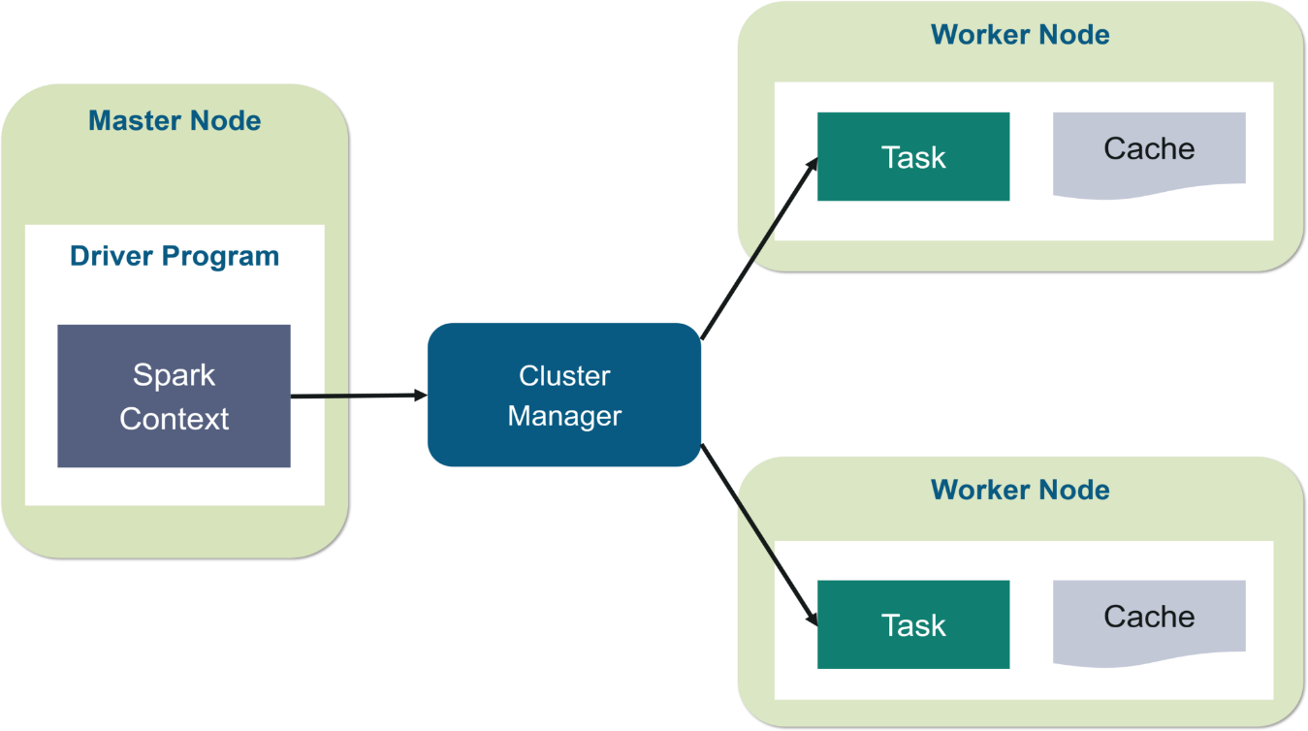
5.2.2 Architecture
At a fundamental level, an Apache Spark application consists of two main components: a driver, which converts the user's code into multiple tasks that can be distributed across worker nodes, and executors, which run on those nodes and execute the tasks assigned to them. Some form of cluster manager is necessary to mediate between the two.
Source:Edureka.co

Slide 9
5.2.3 Components
Spark Core
Spark Core is the heart of the Apache Spark framework. Spark Core provides the execution engine for the Spark platform which is required and used by other components which are built on top of Spark Core as per the requirement.
Spark Core uses a very special data structure called the RDD. Data sharing in distributed processing systems like MapReduce need the data in intermediate steps to be stored and then retrieved from permanent storage like HDFS or S3 . RDDs overcome this as these data structures are in-memory and fault-tolerant and can be shared across different tasks within the same Spark process.
Spark SQL
Spark SQL is named like this because it works with the data in a similar fashion to SQL. In fact it there is a mention that Spark SQL’s aim is to meet SQL 92 standards. The goal is to allow the user to not have to worry about the distributed nature as much and focus on the business use case.

Slide 10
Mllib
MLlib is a low-level machine learning library. It can be called from Java, Scala and Python programming languages. It is simple to use, scalable and can be easily integrated with other tools and frameworks. Mlib eases the deployment and development of scalable machine learning pipelines.
GraphX: For graphs and graph-parallel processing Apache Spark provides another API called GraphX. The graph here does not mean charts, lines or bar graphs, but these are graphs in computer sciences like social networks which consist of vertices where each vertex consists of an individual user in the social network and there are many users connected to each other by edges. These edges represent the relationship between the users in the network.
6. PySpark
PySpark offers PySpark Shell which links the Python API to the spark core and initializes the Spark context. Majority of data scientists and analytics experts today use Python because of its rich library set. Integrating Python with Spark is a boon to them.

